Slide 1
MIGRATION
IN
HISTORY

Slide 2
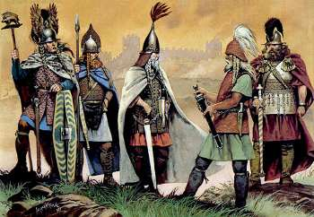
The Celts
The Celts came from Minor Asia, they occupied the British islands between the 8th and 4th century BC; they were organized in tribes and a very important factor in their internal cohesion was religion, which was based on the worship of many gods, in fact they were polytheists.
At the top of the society there was the rich and powerful aristocracy made up of warriors and druids. The Druids were the tribe’s priests.

Slide 3
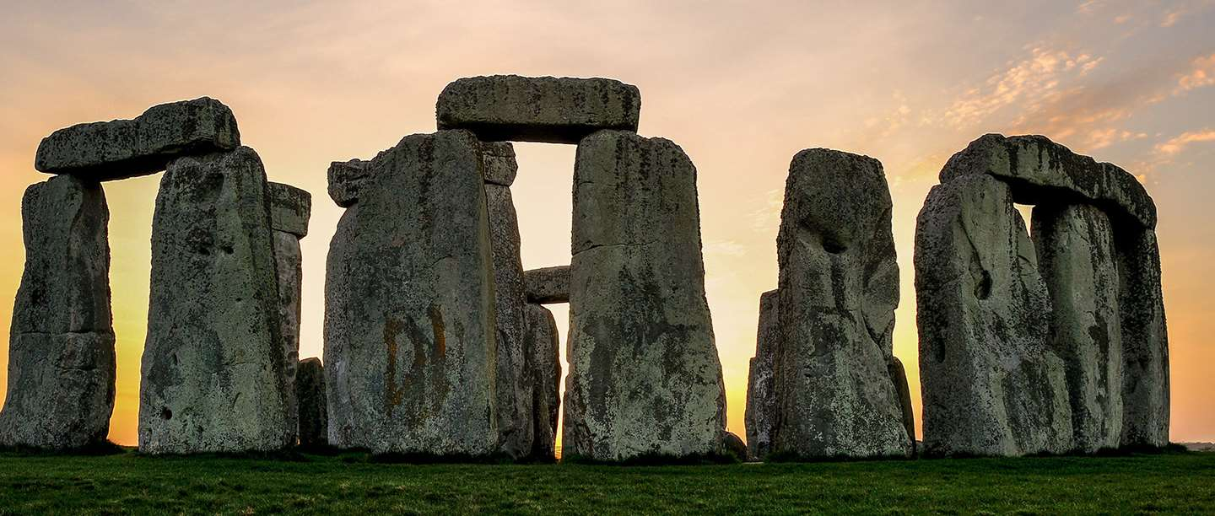
Nowadays we can see many traces of the Celts in Britain, but the most famous work is certainly the Stonehenge. This name originates from stone used for the circular setting of large standing megaliths. Stonehenge is located in Wiltshire, near Salisbury, England.

Slide 4
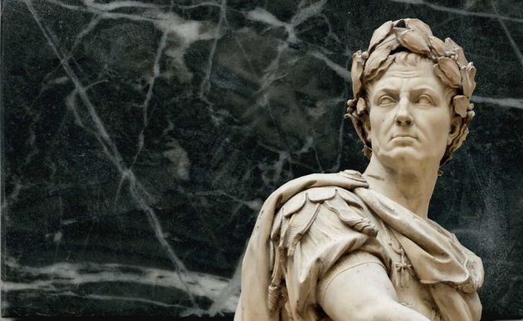
The Romans
The Ancient Romans were interested in Britain from the time of Cesar. Under the emperor Claudius many local tribes were conquered.
We don’t know exactly when Christianity arrived in Roman Britain. Today there are archeology sites on places of worship.

Slide 5
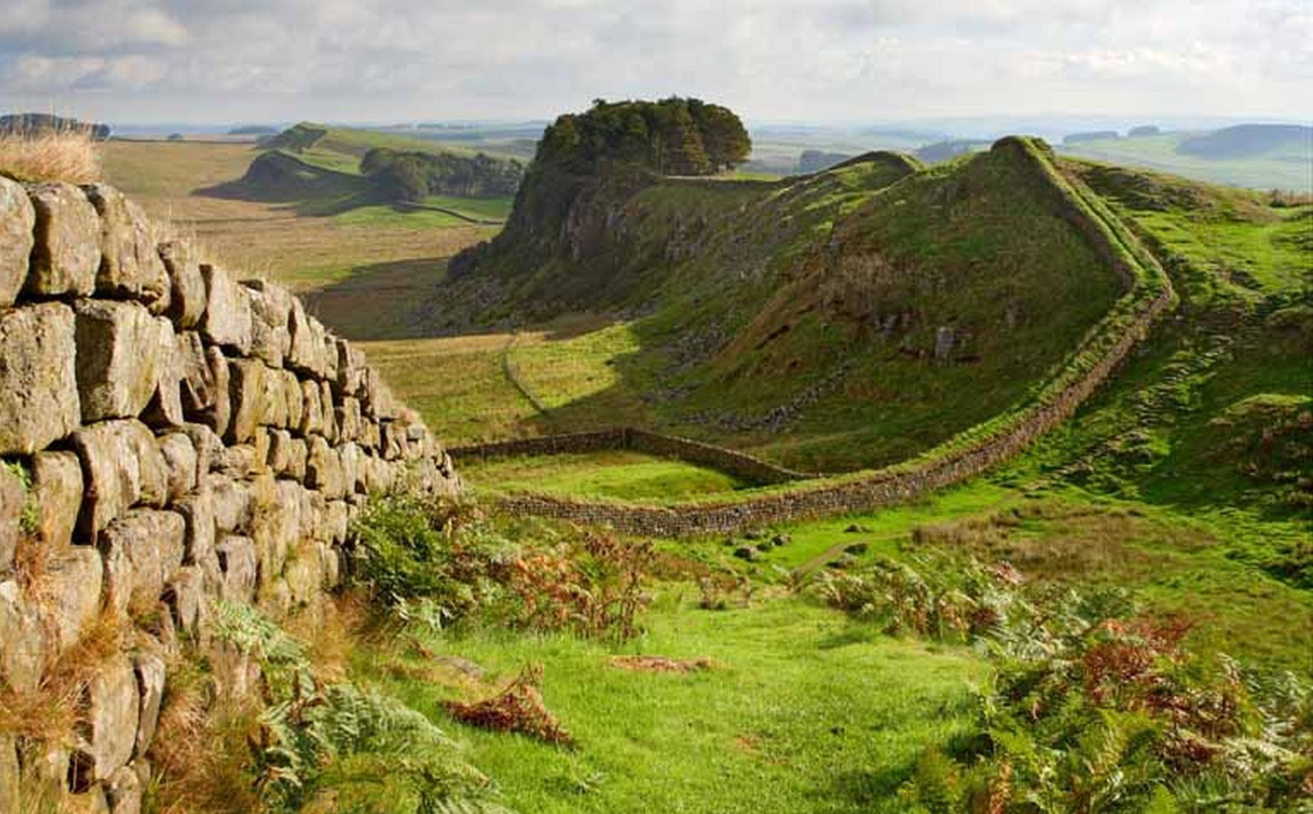
The Roman’s in Britain were challenged by the progressive invasions by sea by Saxons, Angles and Jutes.
The Romans built a wall to defend themselves against the local tribe’s attacks, Hadrian’s Wall; it was in the south of current Scotland.

Slide 6
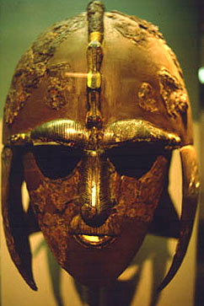
The Anglo-Saxons
‘Anglo-Saxons’ is a term used to describe Germanic people culturally and linguistically similar, who lived in Britain. Their ruling class spoke Germanic languages.
Originally the Anglo-Saxon society was based on peasant communities organized in families of free men in a patriarchal structure.
They migrated to Britain in the 5th and 6th centuries and they formed independent kingdoms. They were farmers in search of richer lands and few of them were fishermen.

Slide 7
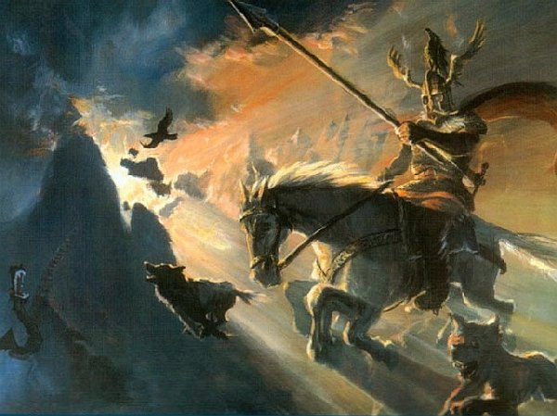
They were pagans and polytheistic: they believed in supernatural beings such as elves and Valkyries and numerous deities. They believed in the Walhalla (the afterlife) and a lot of their gods were related with the war. They converted to Christianity in the 7th century under Augustine of Canterbury

Slide 8
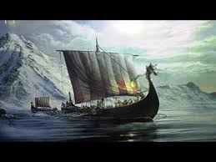
The Vikings
Vikings were Norse warriors from Scandinavia. Boats from Denmark made raids on the coasts of the British Isles, France and other parts of Europe between the end of the 8th and 11th centuries. In this period of European history we normally refers to as the Viking age.
This term can also refer to all the peoples who inhabited Scandinavia during those years and their settlements in other parts of Europe. The Vikings were part of the Norman population.

Slide 9
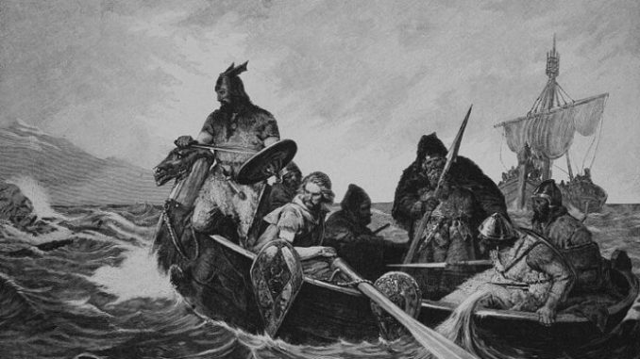
Famous for their ability to navigators and the long boats, the Vikings in a few centuries colonised the coasts and rivers of much of Europe.
The Vikings are also known for being the first discoverers of America, between the late 10th and early 11th century .
The voyages of the Vikings became less frequent after the introduction of Christianity in Scandinavia, between the late 10th and early 11th century.

Slide 10
LOMBARDS
IN
ITALY

Slide 11
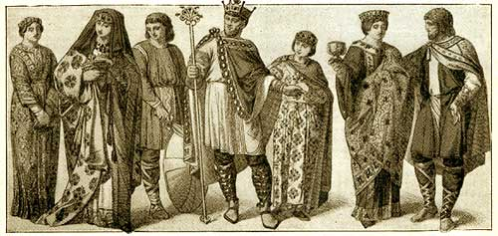
The Lombards were a German people living in current Hungary and they joined the East Roman Empire.
The Longobard society was organised into family clans with a marked military ability. It was divided into three classes: the free, the partially free and the slaves
In 568 lots of Lombards, managed by king Alboino arrived at the italian north east borders.

Slide 12
The Longobard supremacy extended in the north of italy, in Tuscany, Spoleto and Benevento where some military heads called dukes took power.
Alboino died in 572 and after a period of wars between dukes, King Autari was elected. He also married Teodolinda, the Bavarian princess.
The only problem was that Longobards believed in Arianism, which the Catholic church was against.

